Slide 1
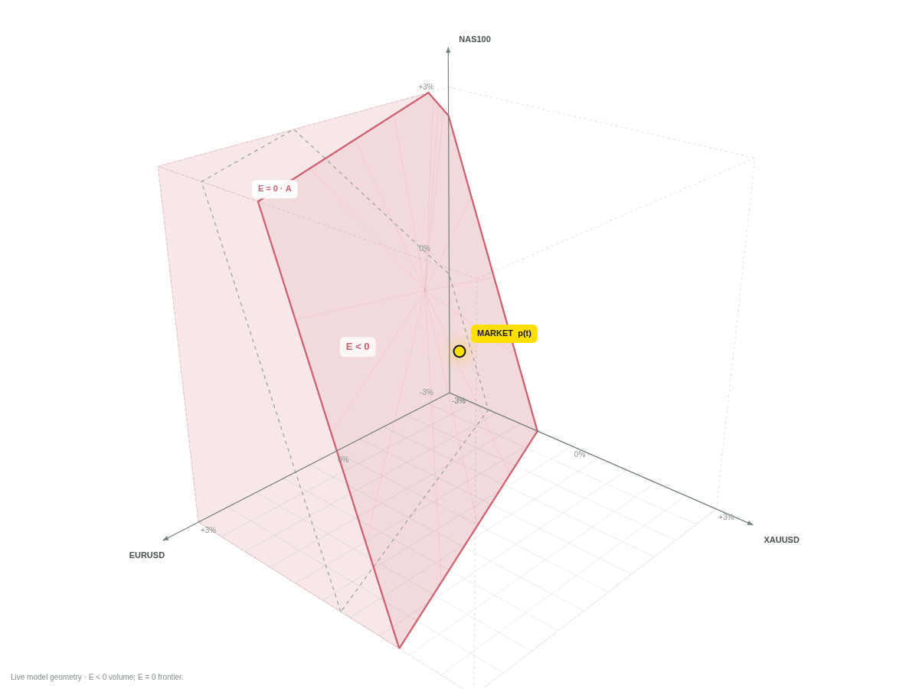
N
NBC / GEOMETRY LAB
PROJECT OVERVIEW / ENGLISH EDITION
NBC
Geometry Lab
Account state.
Market jumps.
A visible mechanism.
A LOCAL, INTERACTIVE RESEARCH EXPERIENCE
Synthetic research illustration • Not historical performance • Model v1.0
01
Notes:
English redesign of the overall project narrative, with a runnable interactive companion. Three scene axes are asset prices, not an equity surface.
MODEL STATUS
All numerical illustrations are synthetic and generated by the included deterministic engine unless explicitly described as a separate analytic example. No live trading, historical tick feed or brokerage compensation is demonstrated. Exness-inspired visual language is not official affiliation. Source: project-owner definitions in NBC description, 14 October 2026. The margin and settlement profile is a laboratory assumption.

Slide 2
N
NBC / GEOMETRY LAB
00 / THE PROJECT
Study the state, not only the trades.
Three mechanisms must be modeled separately, then reconciled.
01 / CONTROL
02 / MARKET
03 / SETTLEMENT
Account state
A discontinuity
Deficit and credit
Cash and signed positions
define an equity function
and a negative domain.
A price or execution jump
can skip the zero-equity
frontier.
Closing determines the deficit.
The selected policy determines
the modeled NBC.
Research question: which admissible state changes alter the expected covered deficit?
Synthetic research illustration • Not historical performance • Model v1.0
02
Notes:
Optimizing expected NBC and optimizing economic return on finite total capital are distinct objectives. Do not start from an assumption of guaranteed profit.
MODEL STATUS
All numerical illustrations are synthetic and generated by the included deterministic engine unless explicitly described as a separate analytic example. No live trading, historical tick feed or brokerage compensation is demonstrated. Exness-inspired visual language is not official affiliation. Source: project-owner definitions in NBC description, 14 October 2026. The margin and settlement profile is a laboratory assumption.

Slide 3
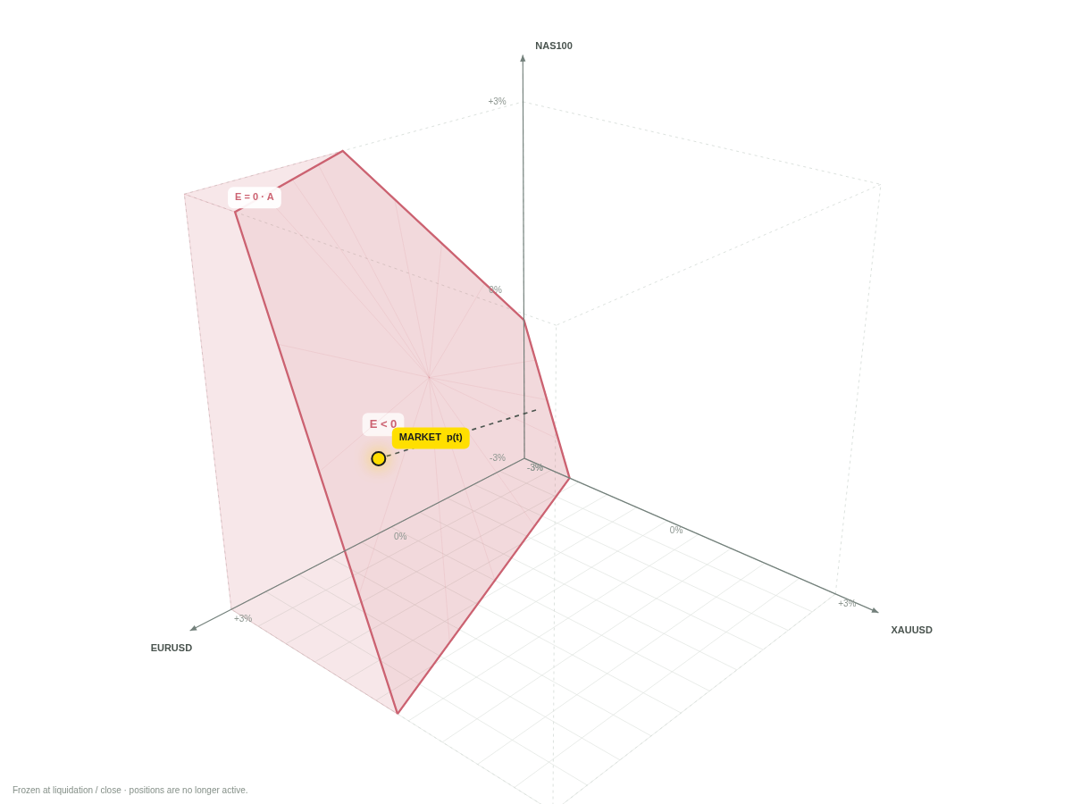
N
NBC / GEOMETRY LAB
01 / FOUNDATIONS
One visual language for the entire project.
Keep market movement, state transformation and cash settlement visually distinct.
MARKET POINT
Yellow point: p(t) in price space.
DOMAIN
Coral volume: E < 0.
FRONTIER
Coral plane: E = 0.
ORIGINAL STATE
Grey outline: initial geometry.
AFTER CLOSE
Frozen geometry is explicitly labeled.
Synthetic research illustration • Not historical performance • Model v1.0
03
Notes:
The cube is only a view window; the linear negative half-space is mathematically unbounded outside valid-price constraints. Dashed jump connectors do not assert intermediate executable prices.
MODEL STATUS
All numerical illustrations are synthetic and generated by the included deterministic engine unless explicitly described as a separate analytic example. No live trading, historical tick feed or brokerage compensation is demonstrated. Exness-inspired visual language is not official affiliation. Source: project-owner definitions in NBC description, 14 October 2026. The margin and settlement profile is a laboratory assumption.

Slide 4
N
NBC / GEOMETRY LAB
01 / FOUNDATIONS
Cash and the signed position vector are the controls.
Equity, used margin and free margin are computed state indicators.
uₜ = ( Dₜ , Wₜ , Δvₜ )
vᵢ > 0 → long
vᵢ < 0 → short
vᵢ = 0 → no net exposure
Deposit or withdraw cash. Increase, reduce or reverse positions.
Every action must be checked at its execution state.
Buying can reduce a short. “Larger position” refers to |vᵢ|, not simply a larger signed number.
Synthetic research illustration • Not historical performance • Model v1.0
04
Notes:
The runtime keeps balance, average entry, signed units, account status, policy and ledger. Net exposure is the analytical projection; a future real brokerage implementation also needs ticket-level orders and contract details.
MODEL STATUS
All numerical illustrations are synthetic and generated by the included deterministic engine unless explicitly described as a separate analytic example. No live trading, historical tick feed or brokerage compensation is demonstrated. Exness-inspired visual language is not official affiliation. Source: project-owner definitions in NBC description, 14 October 2026. The margin and settlement profile is a laboratory assumption.

Slide 5
N
NBC / GEOMETRY LAB
01 / FOUNDATIONS
Equity is an affine function of prices.
Baseline: linear USD contracts and explicit fixed conversion assumptions.
Eₛ(p) = E₀ + wᵀ(p − p₀)
wᵢ = κᵢvᵢ is the signed cash sensitivity to an asset price.
κᵢ includes the contract multiplier and fixed currency conversion.
Changing leverage settings is not an extra multiplier on an already specified trade volume.
Open exposure, effective leverage and margin leverage are different quantities.
Synthetic research illustration • Not historical performance • Model v1.0
05
Notes:
wᵢ = κᵢvᵢ is the signed cash sensitivity to an asset price.
κᵢ includes the contract multiplier and fixed currency conversion.
Changing leverage settings is not an extra multiplier on an already specified trade volume.
MODEL STATUS
All numerical illustrations are synthetic and generated by the included deterministic engine unless explicitly described as a separate analytic example. No live trading, historical tick feed or brokerage compensation is demonstrated. Exness-inspired visual language is not official affiliation. Source: project-owner definitions in NBC description, 14 October 2026. The margin and settlement profile is a laboratory assumption.

Slide 6
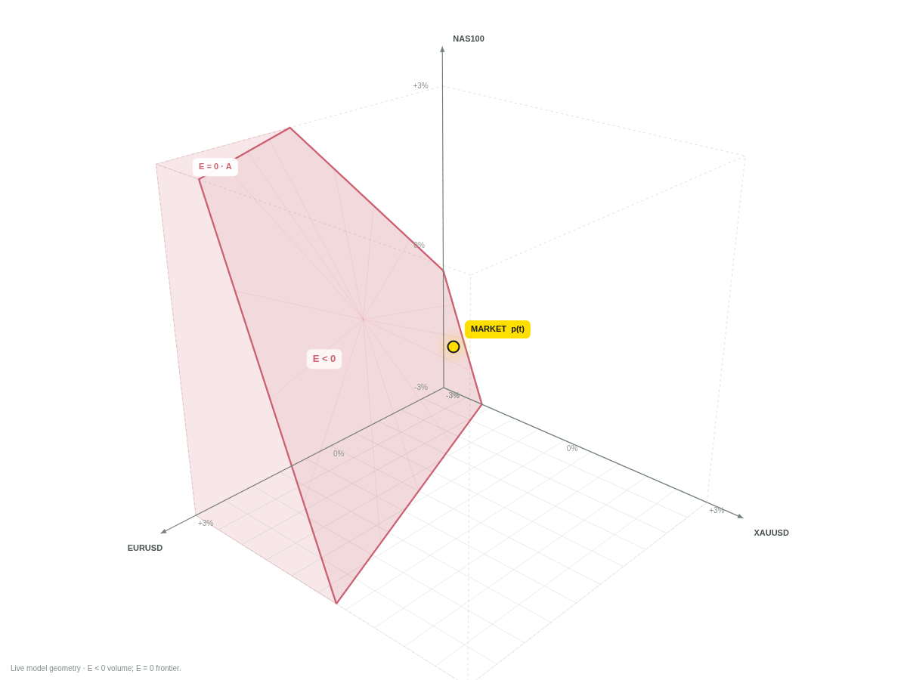
N
NBC / GEOMETRY LAB
01 / FOUNDATIONS
The domain and the frontier are different objects.
A positive compensation requires a strictly negative final deficit.
Dₛ = { p : Eₛ(p) ≤ 0 }
Fₛ = { p : Eₛ(p) = 0 }
On the frontier, NBC = 0.
Inside E < 0, a deficit is possible.
Coverage is a separate assumption.
Synthetic research illustration • Not historical performance • Model v1.0
06
Notes:
User-defined Stop Out Price Domain means equity ≤ 0. This is not automatically the broker margin-liquidation trigger. In degenerate states, e.g. zero exposure and zero balance, a level set need not be a separating frontier. The renderer marks closed geometry as frozen.
MODEL STATUS
All numerical illustrations are synthetic and generated by the included deterministic engine unless explicitly described as a separate analytic example. No live trading, historical tick feed or brokerage compensation is demonstrated. Exness-inspired visual language is not official affiliation. Source: project-owner definitions in NBC description, 14 October 2026. The margin and settlement profile is a laboratory assumption.

Slide 7
N
NBC / GEOMETRY LAB
01 / FOUNDATIONS
One asset: the frontier is a price threshold.
A long position has its negative domain below the threshold; a short has it above.
p* = p₀ − E₀ / w
Illustration
p₀ = 100 · E₀ = $10,000
10,000 units long → p* = 99
E = 0
Current market
E < 0
97
98
99
100
101
102
103
At 99 the account reaches zero. A next executable quote below 99 can create a deficit.
Synthetic research illustration • Not historical performance • Model v1.0
07
Notes:
Separate analytic illustration, not the three-asset base account. Valid-price constraints must be respected: an unreachable zero-equity threshold does not create an attainable negative domain.
MODEL STATUS
All numerical illustrations are synthetic and generated by the included deterministic engine unless explicitly described as a separate analytic example. No live trading, historical tick feed or brokerage compensation is demonstrated. Exness-inspired visual language is not official affiliation. Source: project-owner definitions in NBC description, 14 October 2026. The margin and settlement profile is a laboratory assumption.

Slide 8
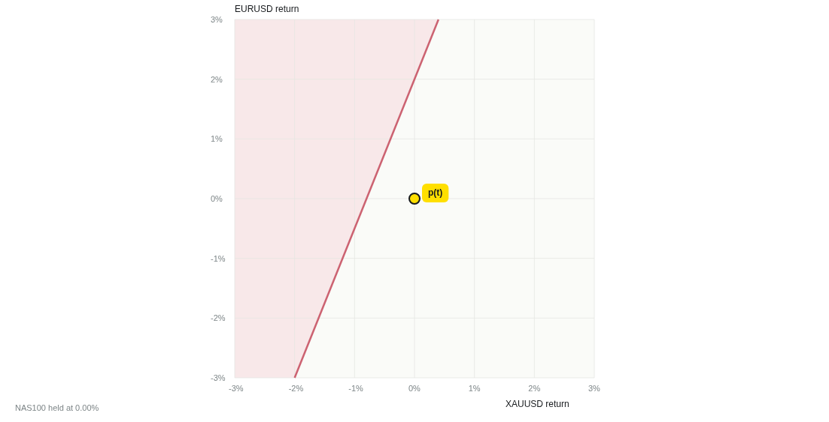
N
NBC / GEOMETRY LAB
01 / FOUNDATIONS
Two assets: a line divides the price plane.
The third coordinate is held fixed in this conditional slice.
2D slice ≠ a projection
that discards risk.
The fixed coordinate still contributes
to equity through the intercept.
Moving it shifts the line.
Synthetic research illustration • Not historical performance • Model v1.0
08
Notes:
At fixed r3=z, the slice is c + n1*r1 + n2*r2 + n3*z ≤ 0. This is not a 2D projection of a cloud or a claim that the third asset has no exposure.
MODEL STATUS
All numerical illustrations are synthetic and generated by the included deterministic engine unless explicitly described as a separate analytic example. No live trading, historical tick feed or brokerage compensation is demonstrated. Exness-inspired visual language is not official affiliation. Source: project-owner definitions in NBC description, 14 October 2026. The margin and settlement profile is a laboratory assumption.

Slide 9
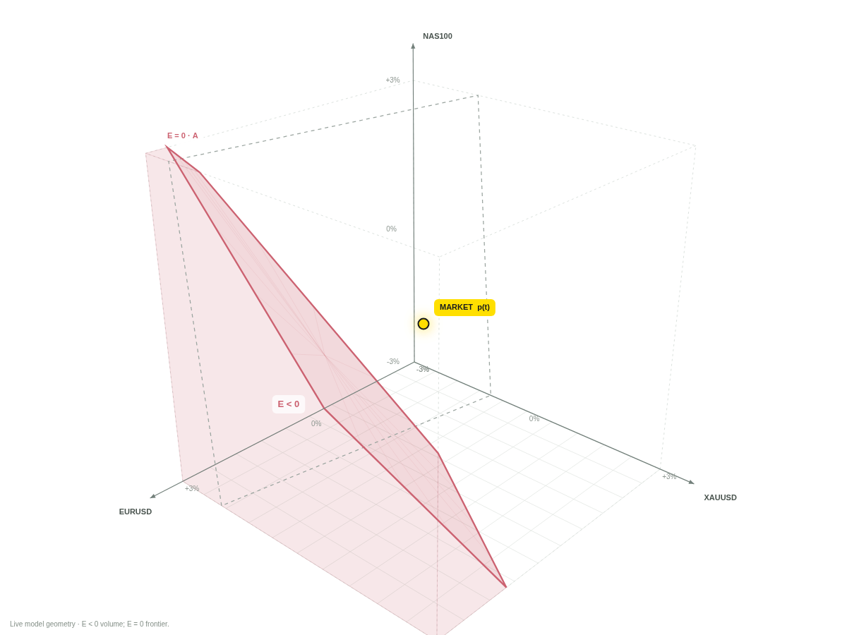
N
NBC / GEOMETRY LAB
01 / FOUNDATIONS
Three asset prices. Not an equity mountain.
The height axis is NAS100 price. Equity is encoded by the domain and the account cards.
p =
(p₁, p₂, p₃)
Orbit the camera.
Inspect the volume.
Keep the math fixed.
Synthetic research illustration • Not historical performance • Model v1.0
09
Notes:
Canvas rendering uses genuine 3D coordinates, camera projection and depth-sorted convex faces. A WebGL dependency is not required for this visualization. The chosen return coordinates are invertibly mapped to raw prices.
MODEL STATUS
All numerical illustrations are synthetic and generated by the included deterministic engine unless explicitly described as a separate analytic example. No live trading, historical tick feed or brokerage compensation is demonstrated. Exness-inspired visual language is not official affiliation. Source: project-owner definitions in NBC description, 14 October 2026. The margin and settlement profile is a laboratory assumption.

Slide 10
N
NBC / GEOMETRY LAB
01 / FOUNDATIONS
For N assets, show an honest conditional slice.
The app supports imported scenarios with three to eight assets and a selectable three-axis view.
E = c̃ + n₁r₁ + n₂r₂ + n₃r₃
c̃ = c + Σ nᵢrᵢ for all hidden coordinates
Relabel the three visible axes as 1, 2 and 3.
Keep every hidden asset’s current P&L in the intercept.
A 3D picture of an N-dimensional state must say which coordinates are held fixed.
Synthetic research illustration • Not historical performance • Model v1.0
10
Notes:
The engine computes all dimensions. The visual slice uses exactly three distinct asset indices. A one- or two-asset strategy is embedded with zero exposures on unused axes. Synthetic jump-distribution experiments shock only the first three assets; additional coordinates remain fixed.
MODEL STATUS
All numerical illustrations are synthetic and generated by the included deterministic engine unless explicitly described as a separate analytic example. No live trading, historical tick feed or brokerage compensation is demonstrated. Exness-inspired visual language is not official affiliation. Source: project-owner definitions in NBC description, 14 October 2026. The margin and settlement profile is a laboratory assumption.

Slide 11
N
NBC / GEOMETRY LAB
02 / CONTROL
Every action changes the same equity function.
Cash moves shift the level; executed trades change the signed sensitivities.
Eₛ′(p) = Eₛ(p) + D − W − K + Δwᵀ(p − pₜ)
DEPOSIT
WITHDRAW
CHANGE v
Raises current equity.
Shrinks the negative domain.
Lowers current equity.
Expands the negative domain.
Changes orientation and slope.
Not uniformly safer or riskier.
The formula assumes execution at pₜ; K captures explicit execution costs.
Synthetic research illustration • Not historical performance • Model v1.0
11
Notes:
This is the single-state, zero-spread linear transformation. The engine realizes closed P&L, updates average entry for additions and accounts for fees/slippage when enabled in the JSON policy.
MODEL STATUS
All numerical illustrations are synthetic and generated by the included deterministic engine unless explicitly described as a separate analytic example. No live trading, historical tick feed or brokerage compensation is demonstrated. Exness-inspired visual language is not official affiliation. Source: project-owner definitions in NBC description, 14 October 2026. The margin and settlement profile is a laboratory assumption.

Slide 12
N
NBC / GEOMETRY LAB
02 / CONTROL
Withdraw cash: the point stays still.
The same market and the same positions; only account cash changes.
Before: equity $10,000
After: equity $4,000
A $6,000 withdrawal moves to reserve. Total capital is still $15,000.
Synthetic research illustration • Not historical performance • Model v1.0
12
Notes:
The same market and the same positions; only account cash changes.
A $6,000 withdrawal moves to reserve. Total capital is still $15,000. The diagrams are rendered from actual model states. Cash flows and exposure changes occur in twenty valid synthetic installments during t=4–9 seconds, with market prices held fixed.
MODEL STATUS
All numerical illustrations are synthetic and generated by the included deterministic engine unless explicitly described as a separate analytic example. No live trading, historical tick feed or brokerage compensation is demonstrated. Exness-inspired visual language is not official affiliation. Source: project-owner definitions in NBC description, 14 October 2026. The margin and settlement profile is a laboratory assumption.

Slide 13
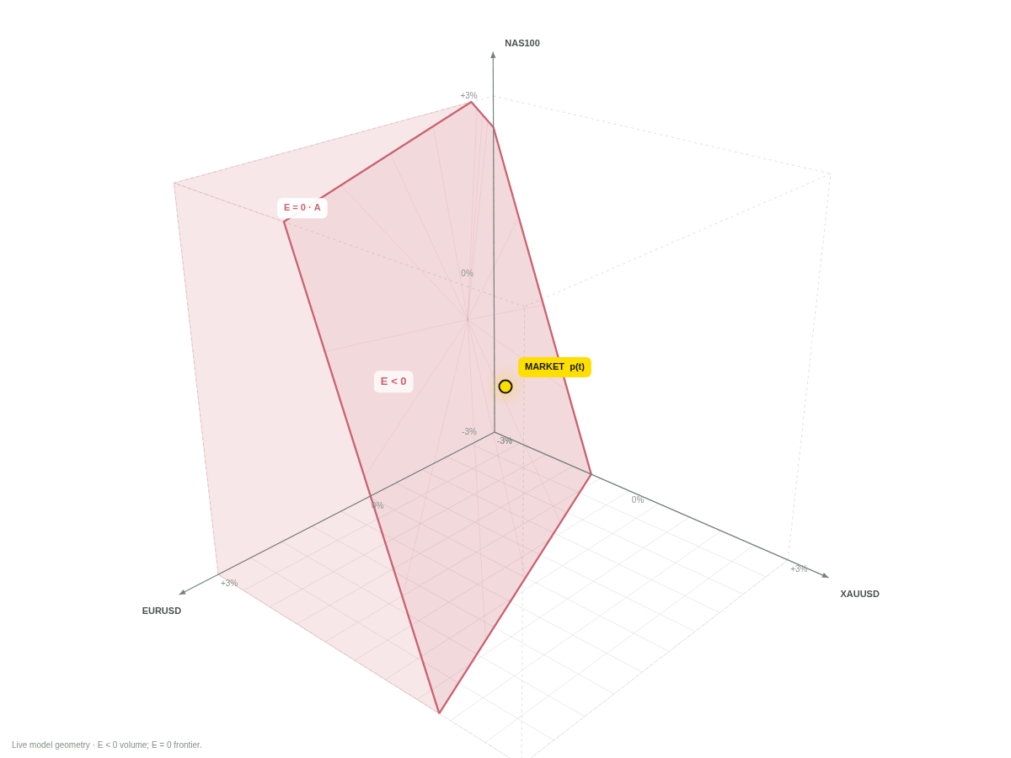
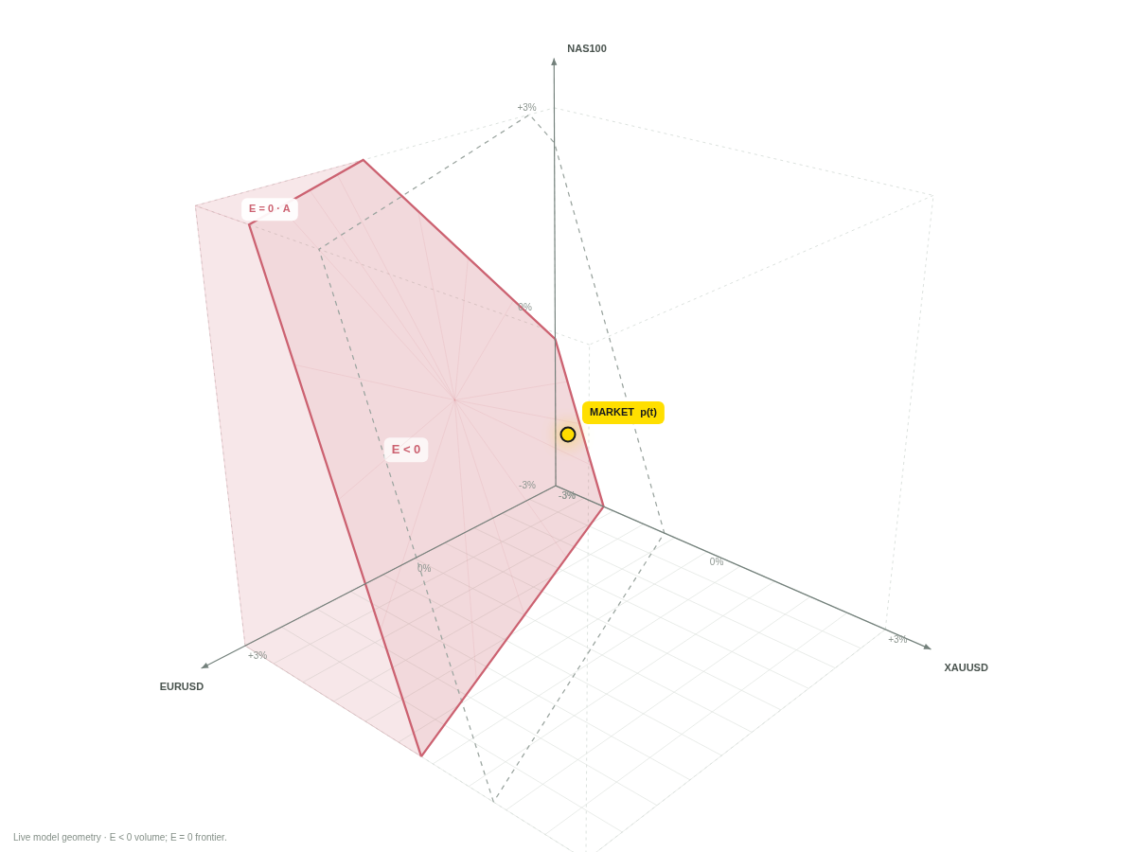
N
NBC / GEOMETRY LAB
02 / CONTROL
Deposit cash: move the frontier away.
Cash comes from the shared reserve rather than appearing as trading profit.
Before: equity $4,000
After: equity $10,000
The same later jump leaves $4,600 equity instead of a $1,400 deficit.
Synthetic research illustration • Not historical performance • Model v1.0
13
Notes:
Cash comes from the shared reserve rather than appearing as trading profit.
The same later jump leaves $4,600 equity instead of a $1,400 deficit. The diagrams are rendered from actual model states. Cash flows and exposure changes occur in twenty valid synthetic installments during t=4–9 seconds, with market prices held fixed.
MODEL STATUS
All numerical illustrations are synthetic and generated by the included deterministic engine unless explicitly described as a separate analytic example. No live trading, historical tick feed or brokerage compensation is demonstrated. Exness-inspired visual language is not official affiliation. Source: project-owner definitions in NBC description, 14 October 2026. The margin and settlement profile is a laboratory assumption.

Slide 14
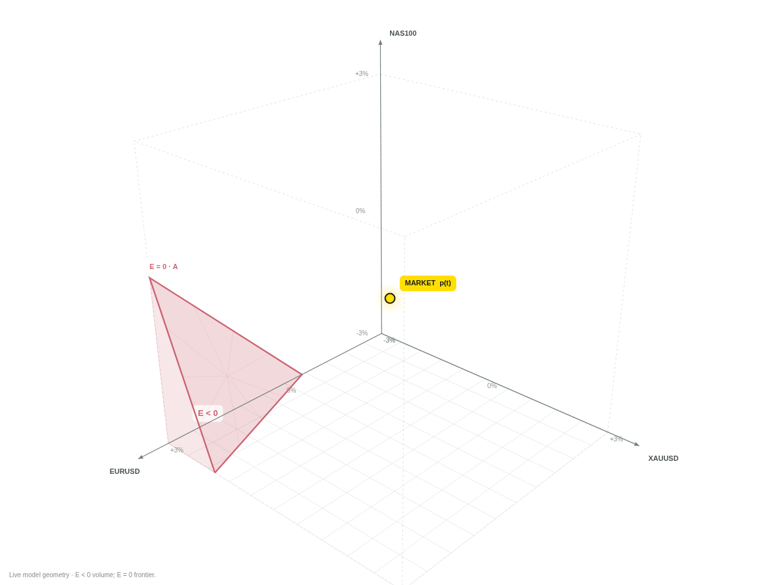
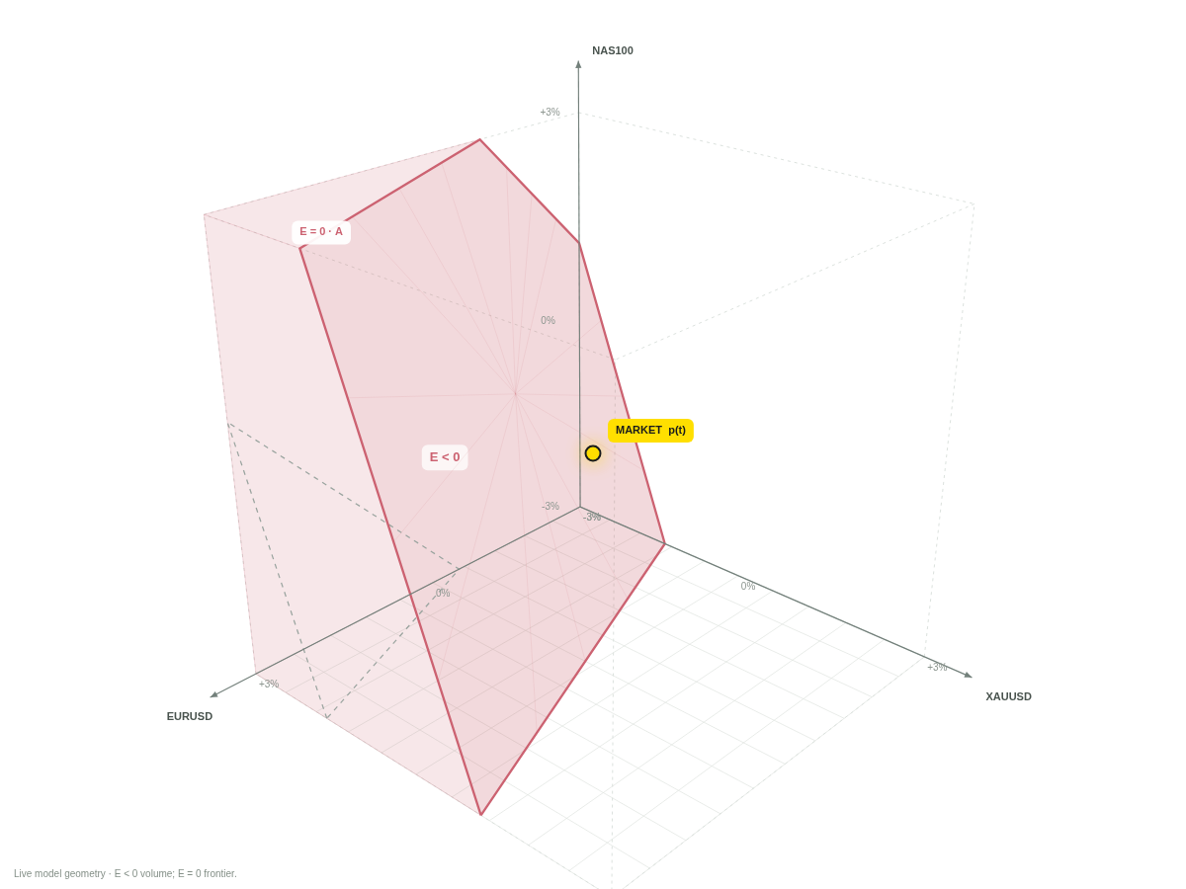
N
NBC / GEOMETRY LAB
02 / CONTROL
Increase positions: a steeper loss profile.
Proportional exposure changes preserve current equity in a zero-cost, fixed-price example.
Before: $450k gross exposure
After: $1.35m gross exposure
The same joint jump produces a $9,800 deficit after increasing the position vector.
Synthetic research illustration • Not historical performance • Model v1.0
14
Notes:
Proportional exposure changes preserve current equity in a zero-cost, fixed-price example.
The same joint jump produces a $9,800 deficit after increasing the position vector. The diagrams are rendered from actual model states. Cash flows and exposure changes occur in twenty valid synthetic installments during t=4–9 seconds, with market prices held fixed.
MODEL STATUS
All numerical illustrations are synthetic and generated by the included deterministic engine unless explicitly described as a separate analytic example. No live trading, historical tick feed or brokerage compensation is demonstrated. Exness-inspired visual language is not official affiliation. Source: project-owner definitions in NBC description, 14 October 2026. The margin and settlement profile is a laboratory assumption.

Slide 15
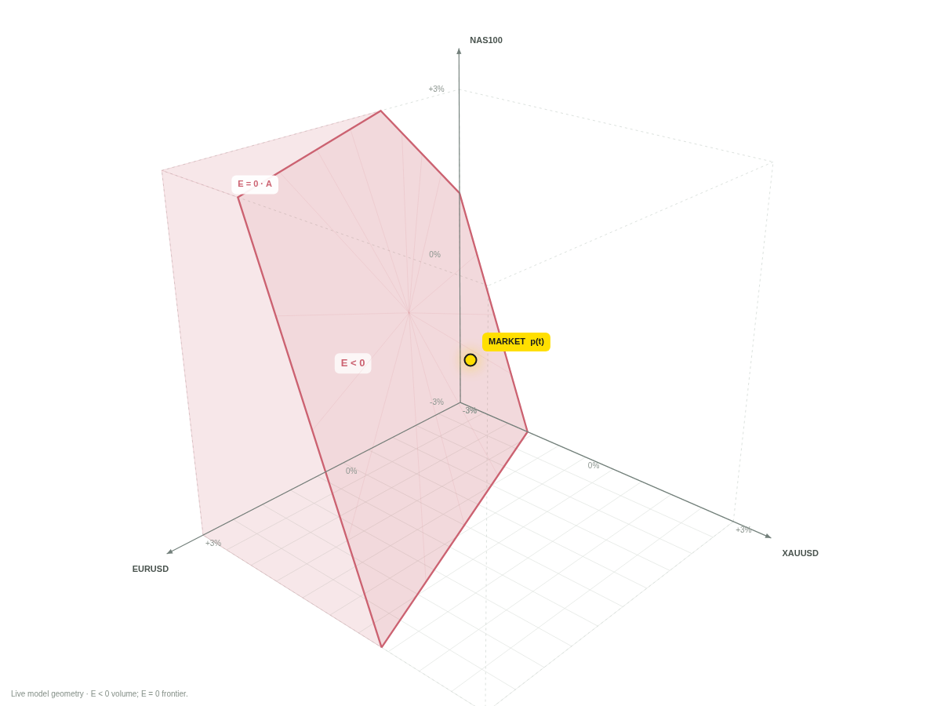

N
NBC / GEOMETRY LAB
02 / CONTROL
Reduce positions: keep equity, change sensitivity.
Closing part of a position does not create equity that was not already present.
Before: $1.35m gross exposure
After: $450k gross exposure
At the same jump, the reduced position survives with $3,400 equity.
Synthetic research illustration • Not historical performance • Model v1.0
15
Notes:
Closing part of a position does not create equity that was not already present.
At the same jump, the reduced position survives with $3,400 equity. The diagrams are rendered from actual model states. Cash flows and exposure changes occur in twenty valid synthetic installments during t=4–9 seconds, with market prices held fixed.
MODEL STATUS
All numerical illustrations are synthetic and generated by the included deterministic engine unless explicitly described as a separate analytic example. No live trading, historical tick feed or brokerage compensation is demonstrated. Exness-inspired visual language is not official affiliation. Source: project-owner definitions in NBC description, 14 October 2026. The margin and settlement profile is a laboratory assumption.

Slide 16
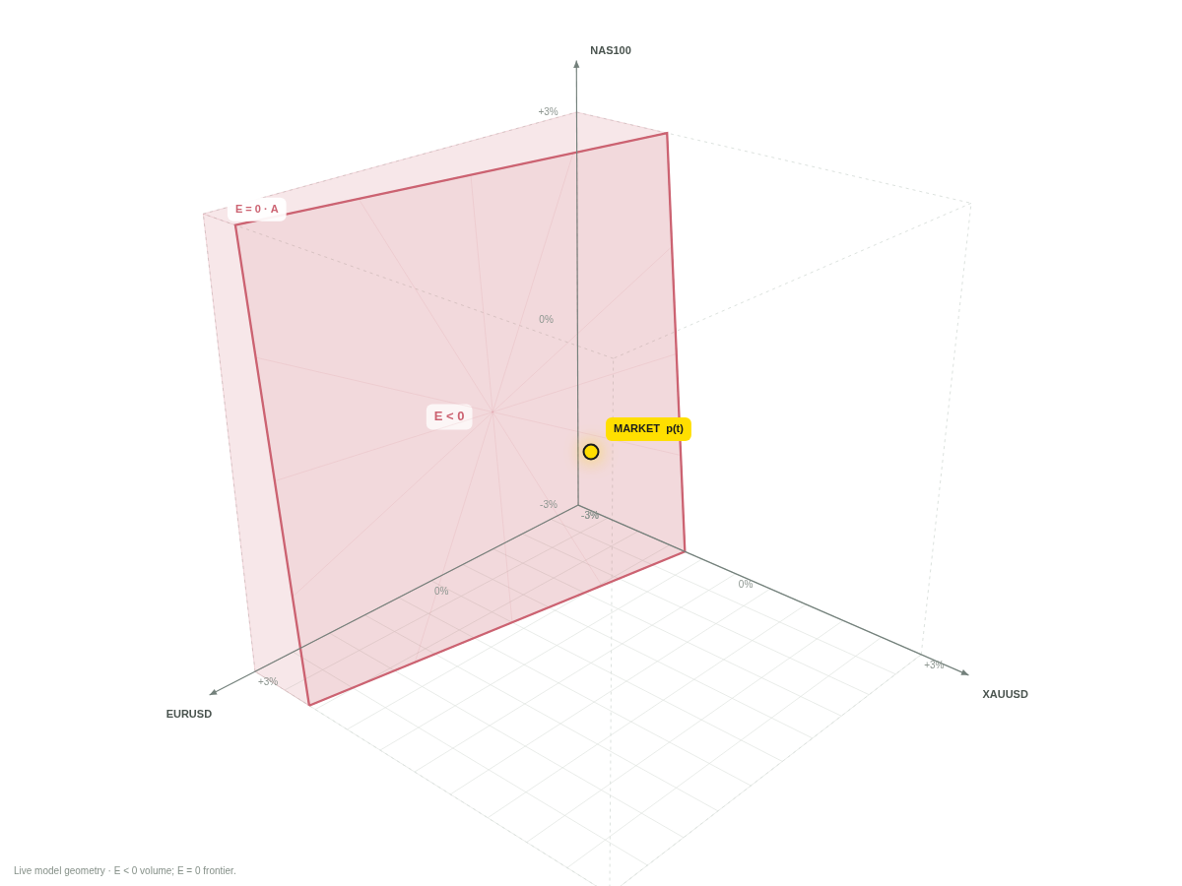
N
NBC / GEOMETRY LAB
02 / CONTROL
Reallocate positions: rotate the frontier.
The exposure vector is also the normal vector of the zero-equity plane in price space.
Before: long all three assets
After: EURUSD turns short
For this specified joint jump, the new exposure vector produces a $5,000 deficit.
Synthetic research illustration • Not historical performance • Model v1.0
16
Notes:
The exposure vector is also the normal vector of the zero-equity plane in price space.
For this specified joint jump, the new exposure vector produces a $5,000 deficit. The diagrams are rendered from actual model states. Cash flows and exposure changes occur in twenty valid synthetic installments during t=4–9 seconds, with market prices held fixed.
MODEL STATUS
All numerical illustrations are synthetic and generated by the included deterministic engine unless explicitly described as a separate analytic example. No live trading, historical tick feed or brokerage compensation is demonstrated. Exness-inspired visual language is not official affiliation. Source: project-owner definitions in NBC description, 14 October 2026. The margin and settlement profile is a laboratory assumption.

Slide 17
N
NBC / GEOMETRY LAB
02 / CONTROL
The admissible state space is constrained.
Every action is checked on its execution state, not against stale free margin.
0 ≤ W ≤ max(E − M, 0)
E after withdrawal ≥ M
Deposits require cash in the shared reserve.
Rebalances must satisfy post-trade margin.
Rejected actions must leave state and ledger unchanged.
A declaration of intent is not an executed action.
Synthetic research illustration • Not historical performance • Model v1.0
17
Notes:
The second formula assumes non-negative starting free margin, unchanged positions/margin and no withdrawal costs. These are laboratory constraints, not a complete specification of a particular real broker. The engine tests rejected rebalance atomicity.
MODEL STATUS
All numerical illustrations are synthetic and generated by the included deterministic engine unless explicitly described as a separate analytic example. No live trading, historical tick feed or brokerage compensation is demonstrated. Exness-inspired visual language is not official affiliation. Source: project-owner definitions in NBC description, 14 October 2026. The margin and settlement profile is a laboratory assumption.

Slide 18
N
NBC / GEOMETRY LAB
03 / DISCONTINUITY
A market jump crosses the account’s geometry.
Use the actual position vector carried immediately before the event.
E⁺ = E⁻ + wᵀJ
Strict deficit condition
wᵀJ < −E⁻
Jump size alone is insufficient.
Its direction relative to w matters.
Synthetic research illustration • Not historical performance • Model v1.0
18
Notes:
The gray dashed connector is explanatory only. The modeled price jumps directly from pre-event to post-event, without invented intermediate fills. Stop-out checks precede High/Low adjustments.
MODEL STATUS
All numerical illustrations are synthetic and generated by the included deterministic engine unless explicitly described as a separate analytic example. No live trading, historical tick feed or brokerage compensation is demonstrated. Exness-inspired visual language is not official affiliation. Source: project-owner definitions in NBC description, 14 October 2026. The margin and settlement profile is a laboratory assumption.

Slide 19
N
NBC / GEOMETRY LAB
03 / DISCONTINUITY
Reaching zero is not the same as overshooting it.
With continuous equity and ideal instant zero-cost close at E = 0, NBC is zero.
Continuous path + exact zero close → NBC = 0
A positive deficit needs an adverse overshoot in liquidation value:
a price gap, unavailable intermediate execution, delayed checks,
slippage or explicit closing costs.
The fundamental discontinuity can be in price or in the ability to execute.
Synthetic research illustration • Not historical performance • Model v1.0
19
Notes:
This is a statement under explicit ideal assumptions, not a general claim that mathematically continuous market prices prevent all negative balances. The whipsaw scenario implements exact crossing interpolation only on explicitly continuous linear segments. Gap scenarios never use that interpolation.
MODEL STATUS
All numerical illustrations are synthetic and generated by the included deterministic engine unless explicitly described as a separate analytic example. No live trading, historical tick feed or brokerage compensation is demonstrated. Exness-inspired visual language is not official affiliation. Source: project-owner definitions in NBC description, 14 October 2026. The margin and settlement profile is a laboratory assumption.

Slide 20
N
NBC / GEOMETRY LAB
03 / PROBABILITY
Expected NBC is frequency times deficit depth.
Use a distribution of executable outcomes, not the visual size of the shaded region.
𝔼[NBC] = P(E < 0) × 𝔼[−E | E < 0]
3.75%
$5,453
$204
Probability of a positive deficit
Conditional mean deficit
Expected modeled NBC
Illustration: 2,000 fixed-seed synthetic draws. Uncalibrated. Not a forecast.
Synthetic research illustration • Not historical performance • Model v1.0
20
Notes:
Numbers are 0.0375, 5452.957623484044, 204.48591088065166. Distribution is a correlated two-scale Gaussian mixture; full coefficients and seed are in engine.js. The account is frozen and assumed to survive to one immediate jump; full close and full deficit coverage are assumed. The sample mean is not a calibrated expectation for a real event.
MODEL STATUS
All numerical illustrations are synthetic and generated by the included deterministic engine unless explicitly described as a separate analytic example. No live trading, historical tick feed or brokerage compensation is demonstrated. Exness-inspired visual language is not official affiliation. Source: project-owner definitions in NBC description, 14 October 2026. The margin and settlement profile is a laboratory assumption.

Slide 21
N
NBC / GEOMETRY LAB
03 / PROBABILITY
The same frontier can hide different deficit sizes.
Geometry alone does not determine the cash scale of compensation.
E₂(p) = k · E₁(p), k > 0
DOMAIN
FRONTIER
COMPENSATION
D₂ = D₁
F₂ = F₁
NBC₂ = k · NBC₁
Always pair frontier geometry with exposure sensitivity and total capital.
Synthetic research illustration • Not historical performance • Model v1.0
21
Notes:
For k>0 the sign regions are identical; max(-kE,0)=k max(-E,0). Scaling capital and exposure can raise absolute compensation without improving the capital-normalized strategy.
MODEL STATUS
All numerical illustrations are synthetic and generated by the included deterministic engine unless explicitly described as a separate analytic example. No live trading, historical tick feed or brokerage compensation is demonstrated. Exness-inspired visual language is not official affiliation. Source: project-owner definitions in NBC description, 14 October 2026. The margin and settlement profile is a laboratory assumption.

Slide 22
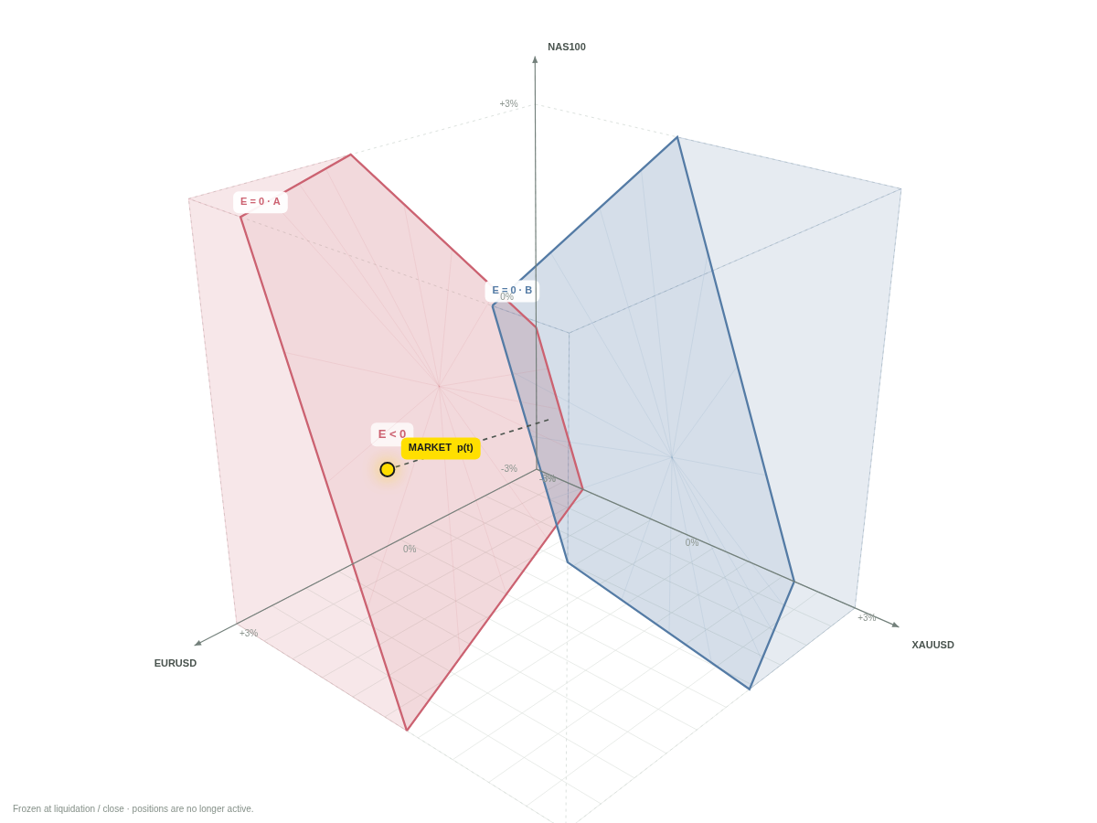
N
NBC / GEOMETRY LAB
04 / MIRROR
Simple Mirror: two domains, one market point.
Opposite exposures are held on independently modeled accounts.
$3,200
Account A / final deficit
$23,200
Account B / equity at same quote
The model credits A once.
It does not net A and B together.
Synthetic research illustration • Not historical performance • Model v1.0
22
Notes:
Both accounts start at $10,000, reserve $5,000. A has reference notionals [500k,-200k,200k], B the opposite. Joint jump [-1.8%,+1.2%,-0.9%] creates ±$13,200 trading P&L. Independent full coverage is an explicit assumption; common-client netting or different eligibility would change the result.
MODEL STATUS
All numerical illustrations are synthetic and generated by the included deterministic engine unless explicitly described as a separate analytic example. No live trading, historical tick feed or brokerage compensation is demonstrated. Exness-inspired visual language is not official affiliation. Source: project-owner definitions in NBC description, 14 October 2026. The margin and settlement profile is a laboratory assumption.

Slide 23
N
NBC / GEOMETRY LAB
04 / MIRROR
The ideal pair has a conditional payoff—not a guarantee.
Separate analytic example: B = $10k and N = $1m on each account; $100 costs per side.
Π(r) = max(N|r| − B + c, 0) − 2c
Portfolio P&L ($k)
NBC > 0
|r| > 0.99%
Net profit > 0
|r| > 1.01%
-2%
-1%
0%
1%
2%
Synthetic research illustration • Not historical performance • Model v1.0
23
Notes:
Analytic payoff assumes both legs survive until the common price move, constant volume, common price exit, symmetric costs and independent full coverage. It ignores path-dependent prior liquidation. A positive NBC does not imply a positive total pair result.
MODEL STATUS
All numerical illustrations are synthetic and generated by the included deterministic engine unless explicitly described as a separate analytic example. No live trading, historical tick feed or brokerage compensation is demonstrated. Exness-inspired visual language is not official affiliation. Source: project-owner definitions in NBC description, 14 October 2026. The margin and settlement profile is a laboratory assumption.

Slide 24
N
NBC / GEOMETRY LAB
04 / MIRROR
A round trip in price can destroy both accounts.
Same final price. Different irreversible account states.
101 / short closes
100 / open pair
100 / both closed
99 / long closes
Final P&L: −$20,000
Total NBC: $0
Synthetic research illustration • Not historical performance • Model v1.0
24
Notes:
Schematic threshold path 100→99→101→100, one long and one short position of $1m on $10k each. The interactive path reaches -1.2% and +1.2% but closes exactly at ±1.0% by its explicitly continuous risk mode. Both outcomes reconcile to zero surviving account capital and zero NBC.
MODEL STATUS
All numerical illustrations are synthetic and generated by the included deterministic engine unless explicitly described as a separate analytic example. No live trading, historical tick feed or brokerage compensation is demonstrated. Exness-inspired visual language is not official affiliation. Source: project-owner definitions in NBC description, 14 October 2026. The margin and settlement profile is a laboratory assumption.

Slide 25
N
NBC / GEOMETRY LAB
04 / DYNAMIC STRATEGIES
High and Low rules reshape carried exposure.
Original semantics are preserved; these are illustrative demo parameters.
ASSYM HIGH
ASSYM LOW
If RL ≥ 150×
close 5% of current units.
If RL ≤ 100×
add 5% of current units.
Demo open leverage: 100×
Four adjustments before the gap.
Demo open leverage: 200×
Five adjustments before the gap.
Risk check → scheduled close → at most one RL action per observed model second.
Synthetic research illustration • Not historical performance • Model v1.0
25
Notes:
Both strategies enter at the start of the synthetic event window, 18 model seconds before the event. T2 close is ten seconds after the event if a position survives. Additions use the current fill and weighted average entry. High reduces current units, not a notional interpreted as initial units. Margin leverage remains 1000 in both demos.
MODEL STATUS
All numerical illustrations are synthetic and generated by the included deterministic engine unless explicitly described as a separate analytic example. No live trading, historical tick feed or brokerage compensation is demonstrated. Exness-inspired visual language is not official affiliation. Source: project-owner definitions in NBC description, 14 October 2026. The margin and settlement profile is a laboratory assumption.

Slide 26
N
NBC / GEOMETRY LAB
05 / ACCOUNTING
Cash transfers are not economic returns.
One finite capital pool contains every account and the shared reserve.
Capital = Σ account equity + reserve
ACCOUNTS
SHARED RESERVE
TOTAL CAPITAL
$10,000 → $4,000
$5,000 → $11,000
$15,000 → $15,000
A modeled NBC credit is a separate ledger event and is counted exactly once.
Synthetic research illustration • Not historical performance • Model v1.0
26
Notes:
This is the withdrawal scenario before its jump. Fees, if enabled, reduce total capital. For continuous multi-event simulations, external funding would need its own classification and must not be included as trading profit. This release resets independent guided trials and labels them synthetic.
MODEL STATUS
All numerical illustrations are synthetic and generated by the included deterministic engine unless explicitly described as a separate analytic example. No live trading, historical tick feed or brokerage compensation is demonstrated. Exness-inspired visual language is not official affiliation. Source: project-owner definitions in NBC description, 14 October 2026. The margin and settlement profile is a laboratory assumption.

Slide 27
N
NBC / GEOMETRY LAB
05 / AUDIT
NBC20 is a frozen-position diagnostic.
Start the clock at actual modeled liquidation τ, not at the scheduled news time.
E₂₀ = Bτ before credit + Σ qᵢ(Pᵢ,τ+20 − Pᵢ,fill)κᵢ
$3,200
$6,000
$0
Credit at liquidation
Frozen equity after recovery
NBC20 after 20 seconds
Never add NBC20 to the balance, actual model credit or economic P&L.
Synthetic research illustration • Not historical performance • Model v1.0
27
Notes:
The frozen units are the actually liquidated remainder, not the initial position. Use the first saved quote at or after τ+20 seconds, with a maximum one-second delay in this profile. If unavailable, report unavailable. No positive initial NBC means not applicable. The example uses zero spread/slippage. The current live-model position stays zero after liquidation.
MODEL STATUS
All numerical illustrations are synthetic and generated by the included deterministic engine unless explicitly described as a separate analytic example. No live trading, historical tick feed or brokerage compensation is demonstrated. Exness-inspired visual language is not official affiliation. Source: project-owner definitions in NBC description, 14 October 2026. The margin and settlement profile is a laboratory assumption.

Slide 28
N
NBC / GEOMETRY LAB
06 / RESEARCH SYSTEM
A scenario space, not a collection of anecdotes.
Test interactions between market paths, account policies and trader actions.
MARKET
EXECUTION
ACCOUNT
No jump · one gap · reversal
Multiple jumps · spread moves
Partial fills · rejection
Delay · slippage · stale quotes
Cash constraints · leverage
Margin changes · separate credit
STRATEGY
CAPITAL
EVIDENCE
Static · asymmetric · High/Low
Mixed or multi-account portfolios
Independent event study
Continuous finite-capital portfolio
Synthetic truth cases
Historical replay · stress tests
Synthetic research illustration • Not historical performance • Model v1.0
28
Notes:
The current executable release implements guided synthetic examples and configurable net-position account mechanics. The broader research space includes historical data, latency, partial execution, multiple events and real policy history. Those items are a roadmap, not features claimed as already live.
MODEL STATUS
All numerical illustrations are synthetic and generated by the included deterministic engine unless explicitly described as a separate analytic example. No live trading, historical tick feed or brokerage compensation is demonstrated. Exness-inspired visual language is not official affiliation. Source: project-owner definitions in NBC description, 14 October 2026. The margin and settlement profile is a laboratory assumption.

Slide 29
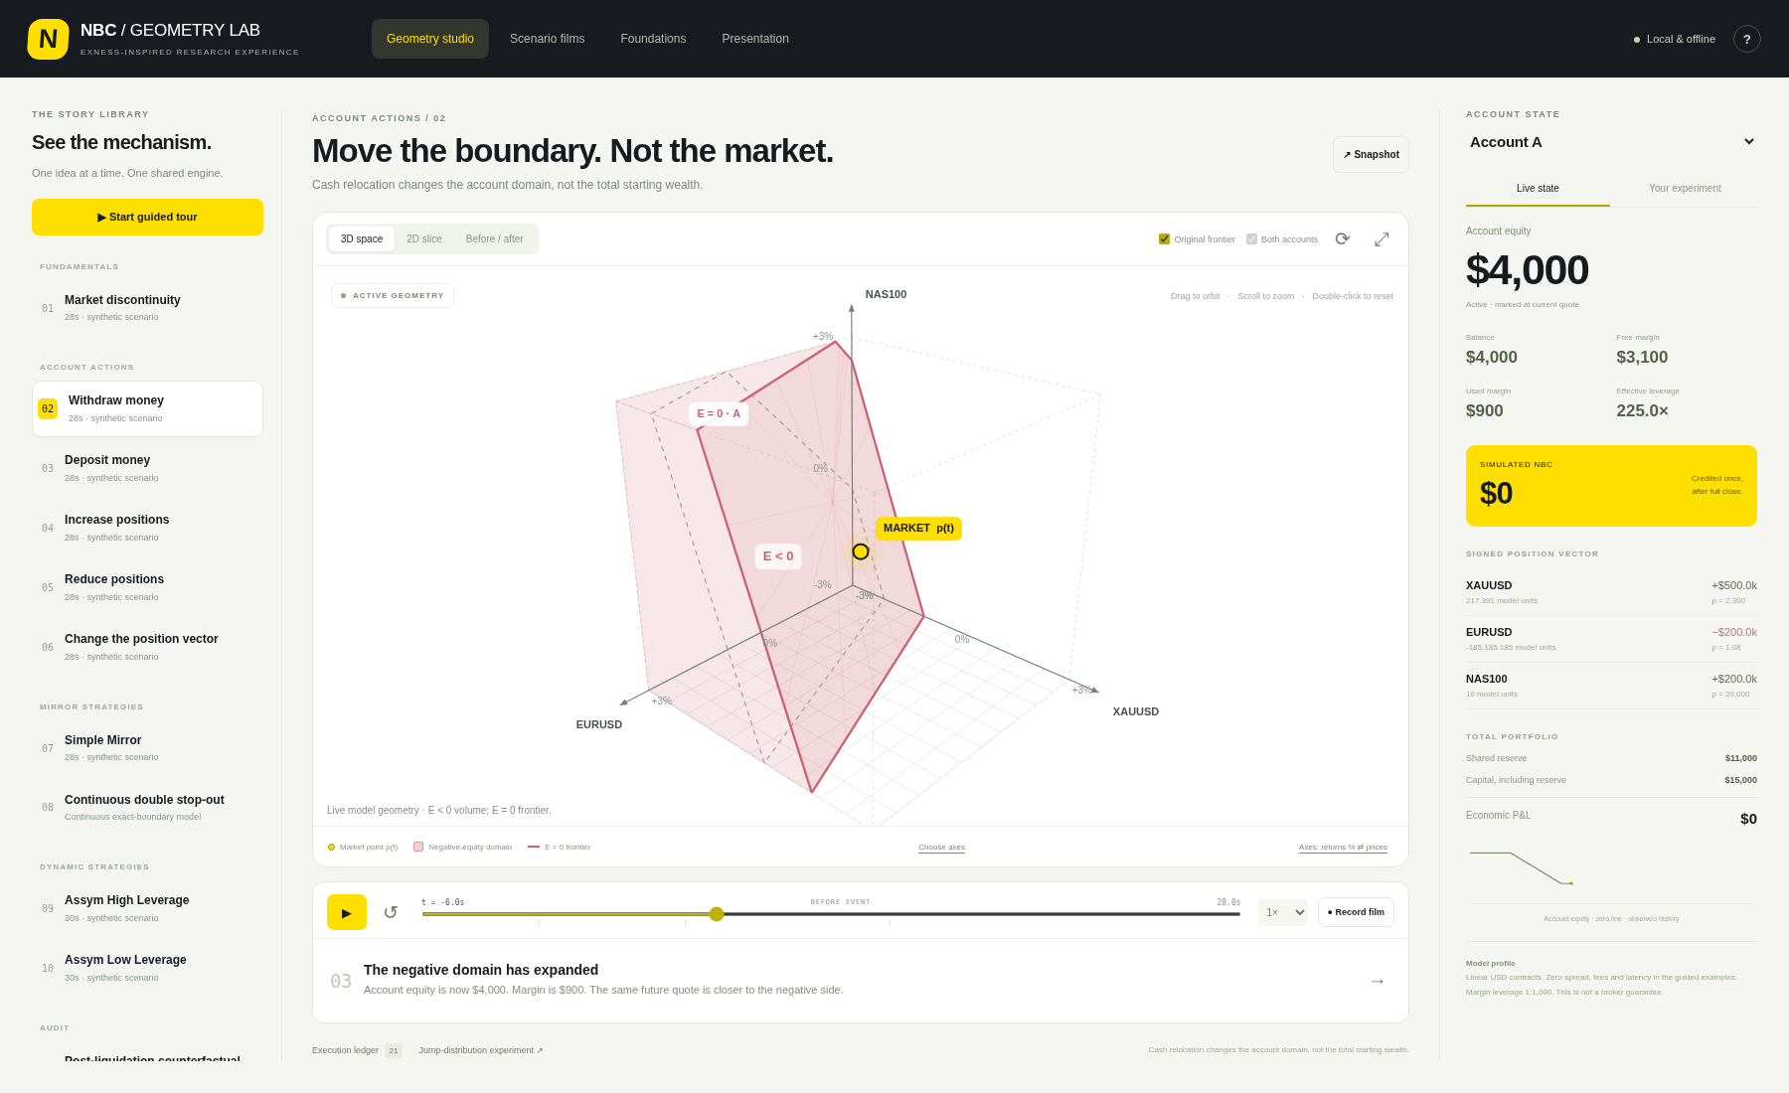
N
NBC / GEOMETRY LAB
06 / INTERACTIVE PRODUCT
One synchronized workspace, built to explain.
The scenario, 3D geometry, account state, captions and ledger share one deterministic state.
Synthetic research illustration • Not historical performance • Model v1.0
29
Notes:
Screenshot of the delivered working application. Main features include camera orbit/zoom, a conditional 2D slice, original/current comparison, timeline, per-account inspection, manual sandbox, import/export JSON, cash ledger export, snapshot export, a synthetic distribution experiment and captioned films.
MODEL STATUS
All numerical illustrations are synthetic and generated by the included deterministic engine unless explicitly described as a separate analytic example. No live trading, historical tick feed or brokerage compensation is demonstrated. Exness-inspired visual language is not official affiliation. Source: project-owner definitions in NBC description, 14 October 2026. The margin and settlement profile is a laboratory assumption.

Slide 30
N
NBC / GEOMETRY LAB
06 / ENGINE DESIGN
The renderer must never decide the financial result.
Every image and every film is derived from the same explicit account state.
Market event
Account engine
Immutable state
Visual layer
Observed quote or
explicit continuous segment
Positions, margin,
realized cash and credit
Replay snapshots
and execution ledger
Volume, frontier,
market point and captions
Scrubbing changes the displayed snapshot. It does not execute the strategy again.
Synthetic research illustration • Not historical performance • Model v1.0
30
Notes:
Normal replay is deterministic at 24 observed model samples per second, not claimed to be historical raw tick replay. Cash and position demonstrations use twenty discrete installments. Geometry clipping and camera motion never mutate the account engine.
MODEL STATUS
All numerical illustrations are synthetic and generated by the included deterministic engine unless explicitly described as a separate analytic example. No live trading, historical tick feed or brokerage compensation is demonstrated. Exness-inspired visual language is not official affiliation. Source: project-owner definitions in NBC description, 14 October 2026. The margin and settlement profile is a laboratory assumption.

Slide 31
N
NBC / GEOMETRY LAB
06 / DATA & AUDIT
Historical research needs the first executable event.
A first post-gap quote must not be silently replaced with the last price of that second.
Pre-gap state → first observed quote → fills → final deficit
Preserve source time, received time and event ordering.
Keep raw prices separate from display normalization.
Version contract, margin and coverage assumptions.
Missing data must be explicit, not a fabricated flat path.
A quoted price alone does not prove that the full position could fill there.
Synthetic research illustration • Not historical performance • Model v1.0
31
Notes:
This slide records the prior Strategy Lab audit lesson: substituting the close of the first post-gap second can miss a deeper opening deficit. Current guided simulations are synthetic and make no historical execution claims. Future data integration must reconcile against source events and actual available fills.
MODEL STATUS
All numerical illustrations are synthetic and generated by the included deterministic engine unless explicitly described as a separate analytic example. No live trading, historical tick feed or brokerage compensation is demonstrated. Exness-inspired visual language is not official affiliation. Source: project-owner definitions in NBC description, 14 October 2026. The margin and settlement profile is a laboratory assumption.

Slide 32
N
NBC / GEOMETRY LAB
07 / ROADMAP
AI proposes. Deterministic code calculates and executes.
The existing on-prem Qwen can become a specification and research agent—not an unrestricted order sender.
Describe
Formalize
Validate
Approve
Execute
Strategy intent
Versioned specification
Tests + reproducible replay
Human-reviewed limits
Deterministic risk gate
No brokerage API, autonomous order agent or AI model is required or connected in this release.
Synthetic research illustration • Not historical performance • Model v1.0
32
Notes:
Target design separates strategy analysis, data semantics, experiment planning, independent numerical verification and approved execution. Real-account adapters require authorization, risk limits, idempotency, reconciliation, recovery controls and a kill switch. The current project is an explanatory local lab.
MODEL STATUS
All numerical illustrations are synthetic and generated by the included deterministic engine unless explicitly described as a separate analytic example. No live trading, historical tick feed or brokerage compensation is demonstrated. Exness-inspired visual language is not official affiliation. Source: project-owner definitions in NBC description, 14 October 2026. The margin and settlement profile is a laboratory assumption.

Slide 33
N
NBC / GEOMETRY LAB
08 / DELIVERY
Open locally. Explore immediately.
The complete project works without a cloud service, CDN, API key or model download.
ZERO INSTALL
LOCALHOST EDITION
OPEN_NBC_LAB.html
START_MAC.command
Unzip the project.
Double-click the file.
Your browser opens the studio.
Uses Python 3.9+ if available.
No packages to install.
Falls back to standalone on Mac.
Included: English presentation, 11 captioned MP4s, source code, scenario JSON and tests.
Synthetic research illustration • Not historical performance • Model v1.0
33
Notes:
The local server binds only to 127.0.0.1 and selects an available port starting at 8768. Launching in the actual user environment has not been performed. The standalone HTML is rebuilt from the same JavaScript modules and CSS by the supplied standard-library bundler.
MODEL STATUS
All numerical illustrations are synthetic and generated by the included deterministic engine unless explicitly described as a separate analytic example. No live trading, historical tick feed or brokerage compensation is demonstrated. Exness-inspired visual language is not official affiliation. Source: project-owner definitions in NBC description, 14 October 2026. The margin and settlement profile is a laboratory assumption.

Slide 34
N
NBC / GEOMETRY LAB
08 / QUALITY & SCOPE
What has been verified—and what has not.
Correct arithmetic, visible assumptions and clear boundaries are part of the product.
34
12
38
Automated JavaScript engine tests
Python launch, HTTP and Decimal tests
Browser interaction checks
Verified in the build environment: cash conservation, full-account NBC, exact-boundary control cases, scenario outputs, perspective interaction, timeline, sandbox rejections and responsive layouts.
Not verified: the user’s Mac, real broker fills, real NBC eligibility or historical profitability.
Synthetic research illustration • Not historical performance • Model v1.0
34
Notes:
Browser interaction tests rendered our standalone HTML in memory because this build environment disallows browser URL navigation. The independent Python suite verifies actual localhost serving, MIME types, byte ranges and traversal rejection. Browser diagnostics add 15 assertions within the UI test. Counts are categories, not a claim of universal production readiness.
MODEL STATUS
All numerical illustrations are synthetic and generated by the included deterministic engine unless explicitly described as a separate analytic example. No live trading, historical tick feed or brokerage compensation is demonstrated. Exness-inspired visual language is not official affiliation. Source: project-owner definitions in NBC description, 14 October 2026. The margin and settlement profile is a laboratory assumption.

Slide 35
N
NBC / GEOMETRY LAB
08 / SOURCES & ASSUMPTIONS
Definitions first. Evidence and provenance always.
The implementation keeps synthetic examples separate from broker policy and real performance.
PROJECT FOUNDATION
The project owner’s NBC / Mirror definitions.
Prior High / Low semantics and NBC20 convention.
Included engine.js, scenarios.js and regression tests.
PUBLIC IMPLEMENTATION REFERENCES
Exness: “Introducing the next level of Exness” — visual inspiration.
MDN: MediaRecorder and isTypeSupported — browser recording.
Full source links, assumptions and reproducibility notes: docs/SOURCES.md.
Synthetic research illustration • Not historical performance • Model v1.0
35
Notes:
Public sources checked 14 October 2026: https://www.exness.com/blog/inside-exness/introducing-the-next-level-of-exness/ ; https://developer.mozilla.org/en-US/docs/Web/API/MediaRecorder ; https://developer.mozilla.org/en-US/docs/Web/API/MediaRecorder/isTypeSupported_static . No Exness font or proprietary brand asset is bundled. All generated mathematical illustrations are original engine output.
MODEL STATUS
All numerical illustrations are synthetic and generated by the included deterministic engine unless explicitly described as a separate analytic example. No live trading, historical tick feed or brokerage compensation is demonstrated. Exness-inspired visual language is not official affiliation. Source: project-owner definitions in NBC description, 14 October 2026. The margin and settlement profile is a laboratory assumption.

Slide 36
N
NBC / GEOMETRY LAB
THE PROJECT THESIS
Move the state.
Watch the frontier.
Audit the outcome.
One model. One replay. Every number traceable.
NBC GEOMETRY LAB / INTERACTIVE RESEARCH
Synthetic research illustration • Not historical performance • Model v1.0
36
Notes:
Closing statement: state changes move the frontier, price events move the point, and verified execution/accounting determines the result. The full runtime and project sources are provided for local use.
MODEL STATUS
All numerical illustrations are synthetic and generated by the included deterministic engine unless explicitly described as a separate analytic example. No live trading, historical tick feed or brokerage compensation is demonstrated. Exness-inspired visual language is not official affiliation. Source: project-owner definitions in NBC description, 14 October 2026. The margin and settlement profile is a laboratory assumption.

